Slide 1

HEART DISEAE PREDICTION USING MACHINE LEARNING
Course Project Presentation
Guided By,
Deepu C
Faculty,
International Centre for Free and Open Source Software (ICFOSS)
Presented By,
Afsal Najeeb

Slide 2
Overview of the project
Tries to apply Machine Learning to predict the presence or absence of heart disease in a patient using Supervised Learning methods
Significance of the project
Heart diseases are difficult to manually detect because of a variety of contributory risk factors like diabetes, high blood pressure, high cholesterol etc.
Large availability of health data sets

Slide 3
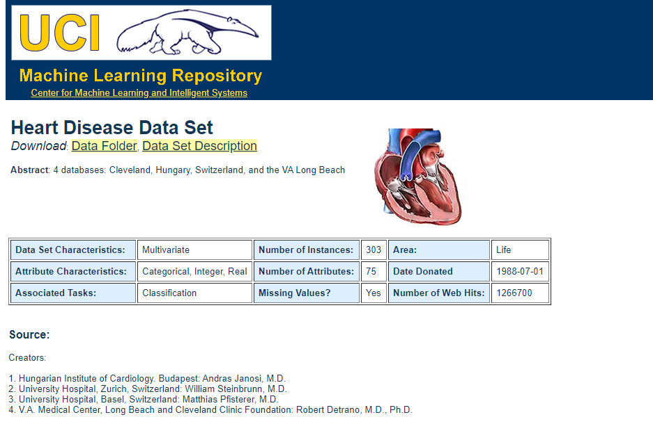
Dataset Used
Widely used for machine learning applications
Presents 14 important parameters as a separate set
Available at
https://archive.ics.uci.edu/ml/datasets/Heart+Disease

Slide 4
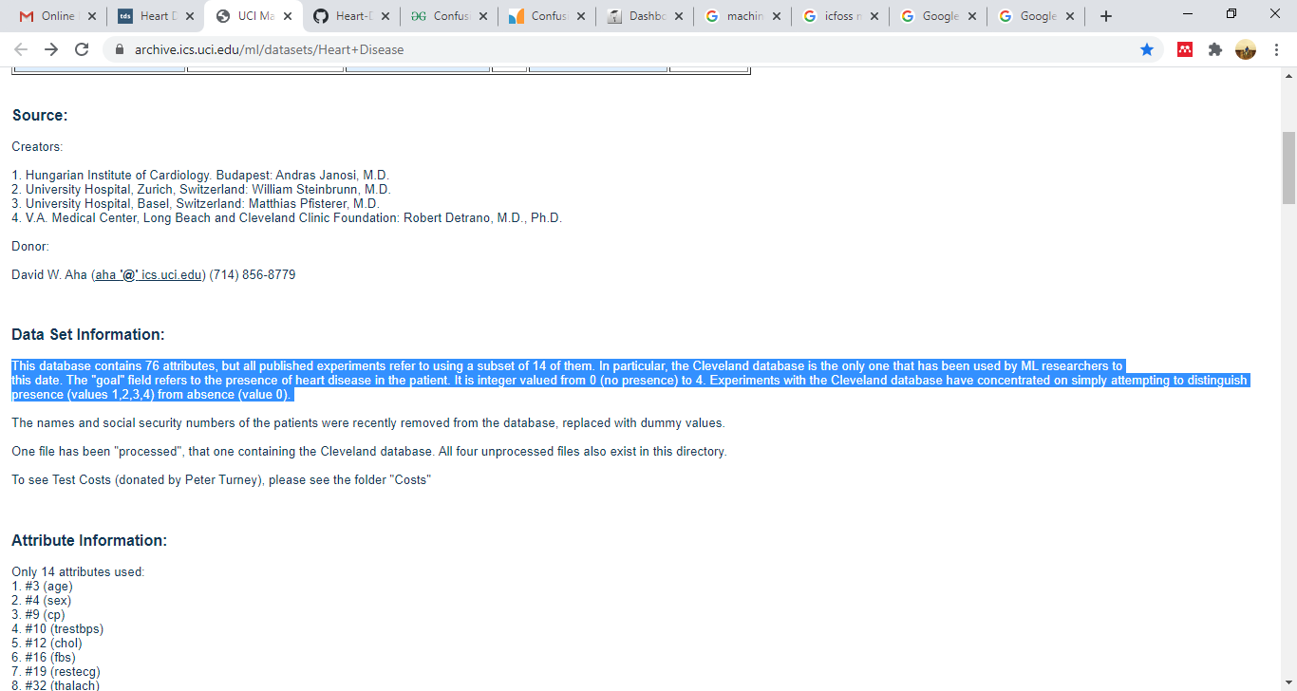
Selection of subset data for analysis

Slide 5
Dataset Description
Sl. No | Parameter | Description | Corresponding column name in the data frame
1 | Age | Age of the patient | Age
2 | Sex | Sex: Male (1) / Female (0) | Sex
3 | Chest-pain type | Type of chest-pain experienced by the individual 1 = typical angina 2 = atypical angina 3 = non - anginal pain 4 = asymptotic | Cp
4 | Resting Blood Pressure | Resting blood pressure value of an individual in mmHg (unit) | trestbps
5 | Serum Cholestrol | Serum cholesterol in mg/dl (unit) | chol
6 | Fasting Blood Sugar | Compares the fasting blood sugar value of an individual with 120mg/dl. If fasting blood sugar > 120mg/dl then : 1 (true) else : 0 (false) | Fbs
7 | Resting ECG | Resting electrocardiographic results 0 = normal 1 = having ST-T wave abnormality 2 = left ventricular hyperthrophy | restecg
8 | Max heart rate achieved | Displays the max heart rate achieved by an individual. | thalach

Slide 6
Dataset Description
9 | Exercise induced angina | 1 = yes 0 = no | exang
10 | ST depression induced by exercise relative to rest | Integer or float | oldpeak
11 | Peak exercise ST segment | Type of slope: 1=upsloping 2=flat 3 = downsloping | slope
12 | Number of major vessels (0–3) colored by flourosopy | 0 / 1 / 2 / 3 | Ca
13 | Thal | Thalassemia : 3 = normal 6 = fixed defect 7 = reversible defect | thal
14 | Diagnosis of heart disease | Displays whether the individual is suffering from heart disease or not : 0 = absence 1, 2, 3, 4 = present | Target

Slide 7
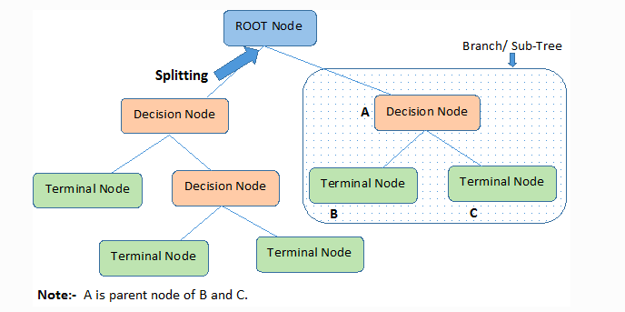
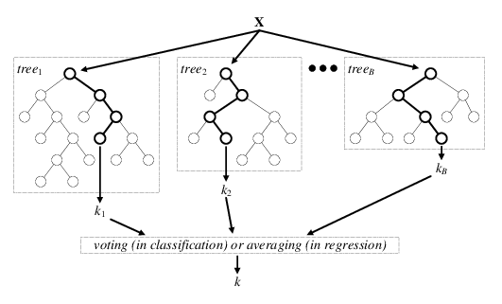
Algorithms Used
Decision Tree
Random Forest

Slide 8
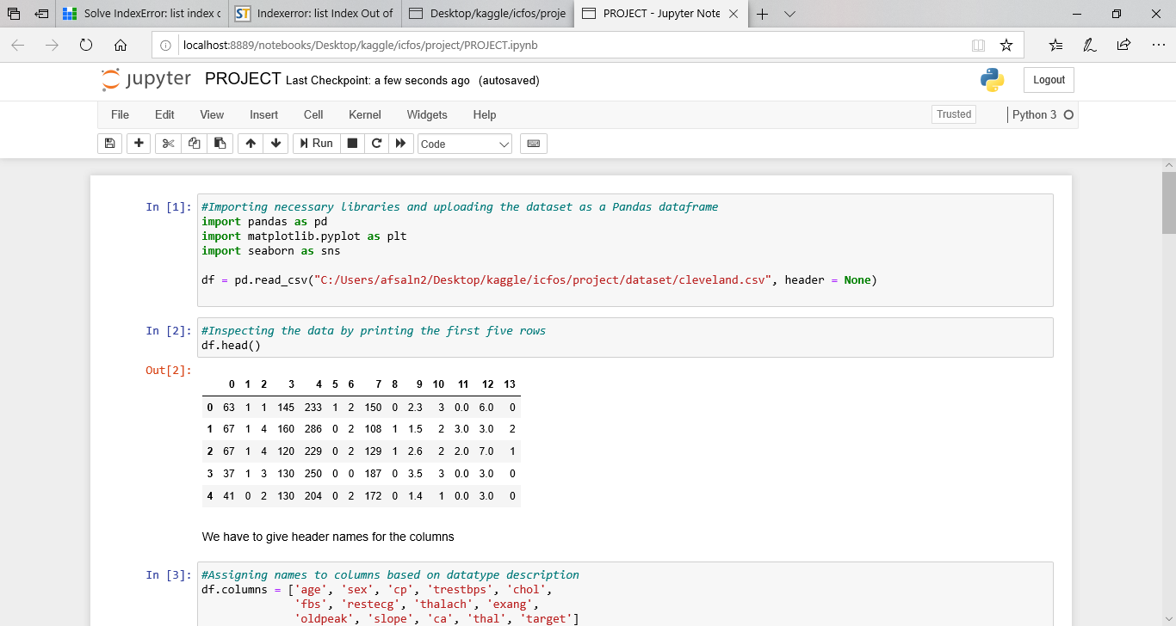
Screenshots

Slide 9
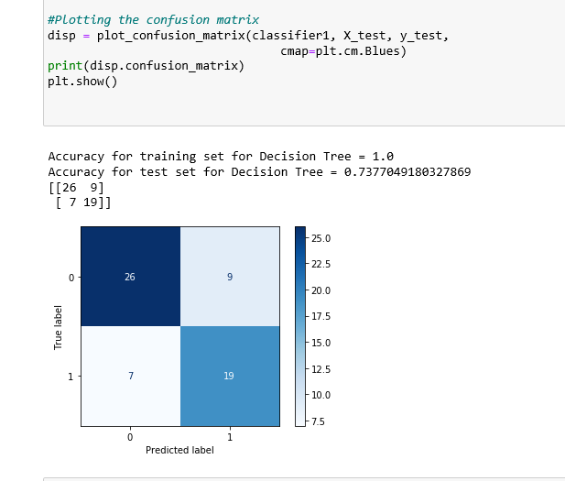

Slide 10
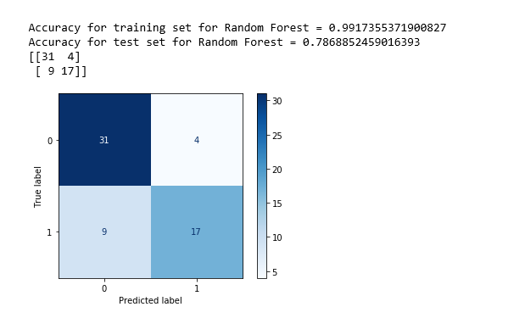

Slide 11
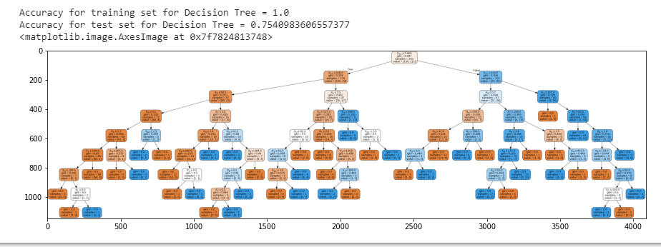

Slide 12
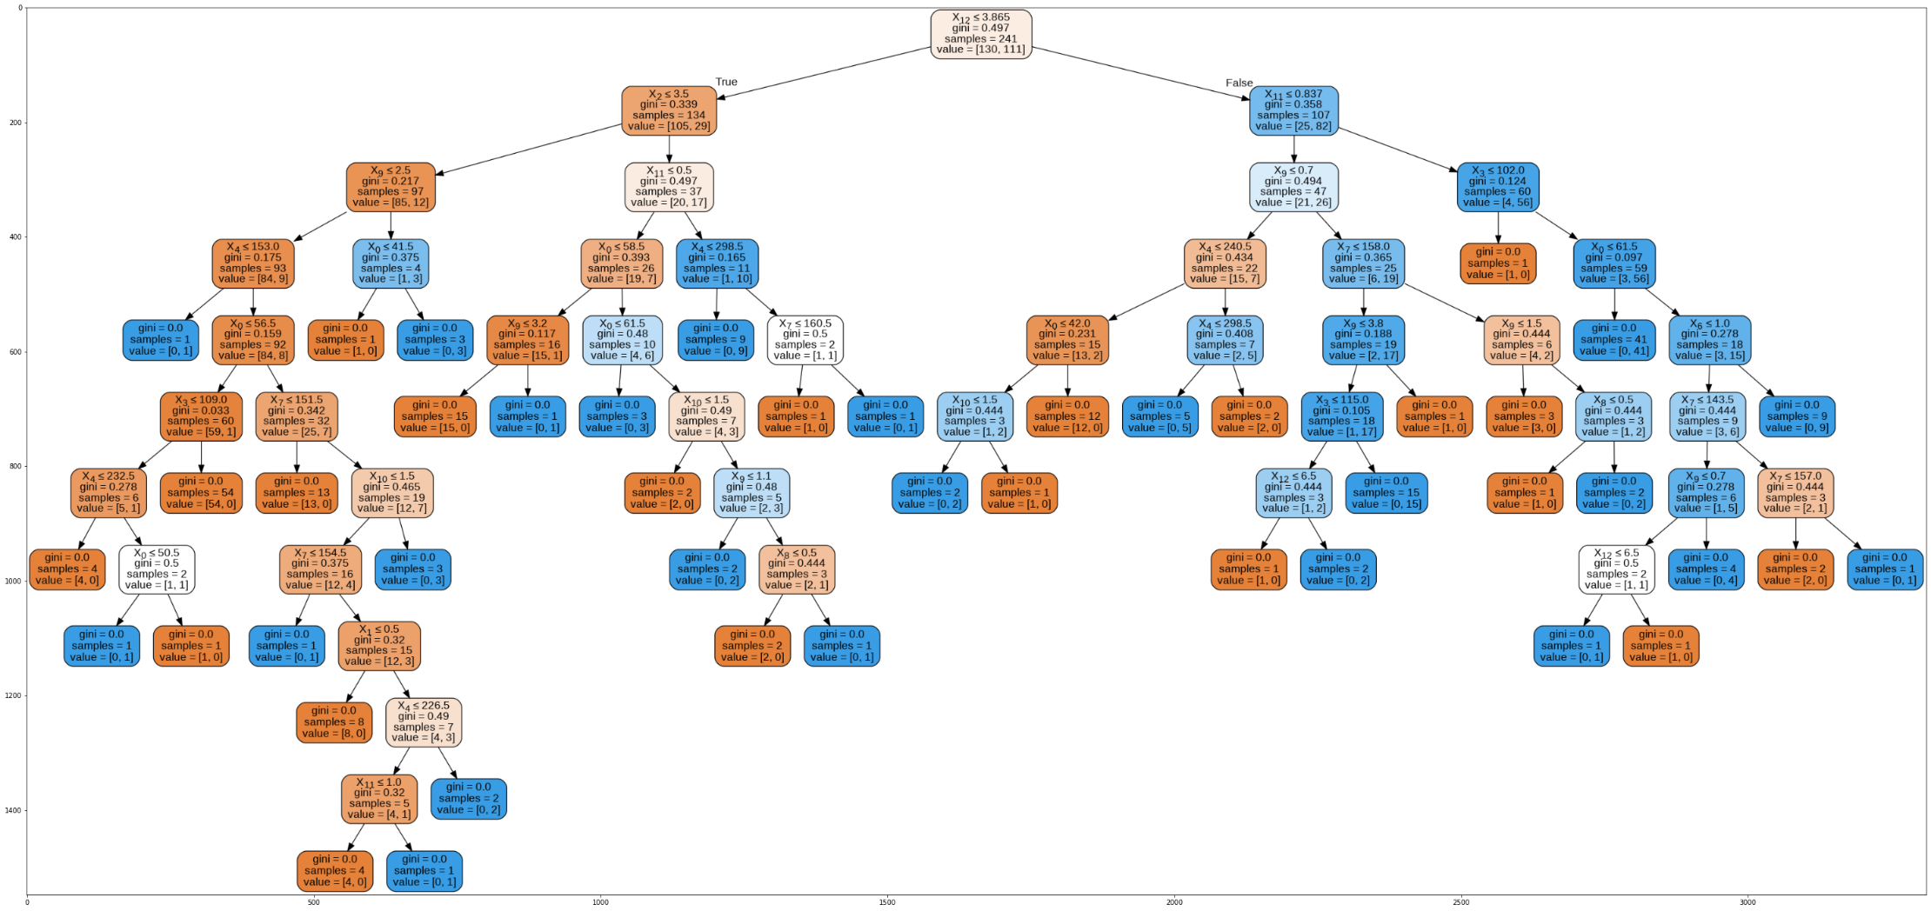

Slide 13
Discussion about results
In most of the cases, the two methods provided the same results
The models have a bias – when large number of inputs are zero
Hence the prediction for a person all details of whom are not available cannot be predicted using this method

Slide 14
References / Online Resources Used
https://archive.ics.uci.edu/ml/datasets/Heart+Disease
Detrano, R., Janosi, A., Steinbrunn, W., Pfisterer, M., Schmid, J., Sandhu, S., Guppy, K., Lee, S., & Froelicher, V. (1989). International application of a new probability algorithm for the diagnosis of coronary artery disease. American Journal of Cardiology, 64,304—310
https://towardsdatascience.com/decision-tree-algorithm-explained-83beb6e78ef4
https://medium.com/@chiragsehra42/decision-trees-explained-easily-28f23241248
https://www.youtube.com/watch?v=7VeUPuFGJHk

Slide 15
References / Online Resources Used
https://towardsdatascience.com/heart-disease-prediction-73468d630cfc

